Slide 1

Analysis of Care Home Deaths 2021-2022 Covid-19, Respiratory Diseases, Influenza and Pneumonia
Notes:
Analysis of Care Home Deaths 2021-2022

Slide 2
Presentation by :
NEHA
2254818

Slide 3
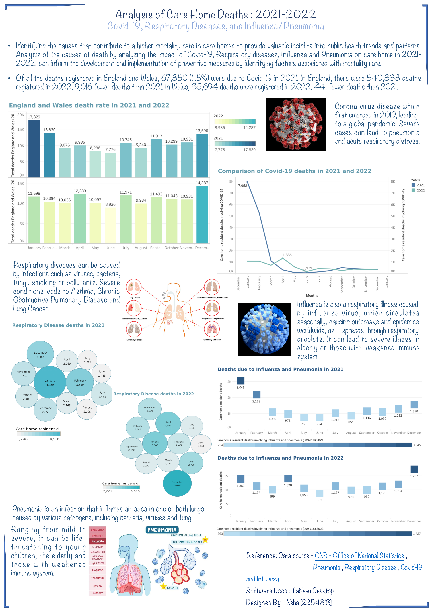
Purpose of the Poster :
This poster gather, analyze and visualize the complex data from ONS (Office for National Statistics) by highlighting the technical proficiency in data visualization using Tableau.
To effectively communicate the research findings in a poster format through visualizations and concise explanations, the poster presents the trends and patterns in care home deaths related to Covid-19, Respiratory Diseases, Influenza and Pneumonia.
Contribution especially in terms of infectious disease management and preventive measures.
Although, this poster is for academic purpose, it helps to discuss the practical implications of the findings among the researchers, healthcare professionals, policymakers and the public, leading to potential improvements in care home settings.

Slide 4
Analysis of Care Home Deaths : 2021 - 2022
Timeliness : The study period covers the years 2021 and 2022, which are crucial in the context of Covid-19 pandemic. Analyzing the data for these specific years can provide valuable insights into the impact of the pandemic on care home mortality.
United Kingdom – England and Wales
Societal Importance : Care homes play a significant role in providing care and support to vulnerable populations. Analyzing the causes of deaths in these settings helps identify areas that require improved health services and targeted interventions.

Slide 5
Color Combination and Poster Space Usage : The color combination of shades of blue and green used across the poster helps in differentiating the regions, time periods, and proportions of deaths by enhancing its visual appeal, facilitating data interpretation and conveying information effectively. Efficient use of space is crucial aspect of any poster design to maximize clarity, readability and the overall impact of the content. Ample space is given around each visualization to prevent clutter and ensure that the information is digestible. Clear and concise titles and headings are used to introduce each section of the poster. Titles are positioned prominently to guide the viewer through the content and help them understand the focus of each visualization. Appropriate legends and labels are placed near their respective visualizations ensuring the viewers to quickly grasp the context. In addition, the pictures representing Covid-19, Respiratory diseases, Influenza and Pneumonia are thoughtfully placed beside their respective sections of the poster which serves as visual cues to reinforce the topic. The effective use of white space (empty space) is essential to avoid overlapping which helps the content breathe, making it more accessible, engaging and less cluttered.

Slide 6


Histogram : This provides a visual representation of death rates in England and Wales for the years 2021 and 2022, by grouping the data into intervals such as months which facilitates easy comparison between the two years. By utilizing the legend to explain the year, highest and the lowest death rates ensuring the clarity and understanding. Histogram is particularly effective for showcasing the frequency of occurrences in different ranges, highlighting any notable shifts or trends.

Slide 7


Line Graph : By comparing the number of deaths in 2021 and 2022 due to Covid-19, this visualization allows the identification of any significant changes or fluctuations in the mortality rate with respect to the time period (months). Lines demonstrate the overall trend, whether its increasing, decreasing or is stable. Both the lines are represented in the same visual in different colors by specifying it in the legend. This format enables the viewer to quickly grasp the impact of pandemic on care home deaths and aids in the assessment of preventive measures implemented.

Slide 8
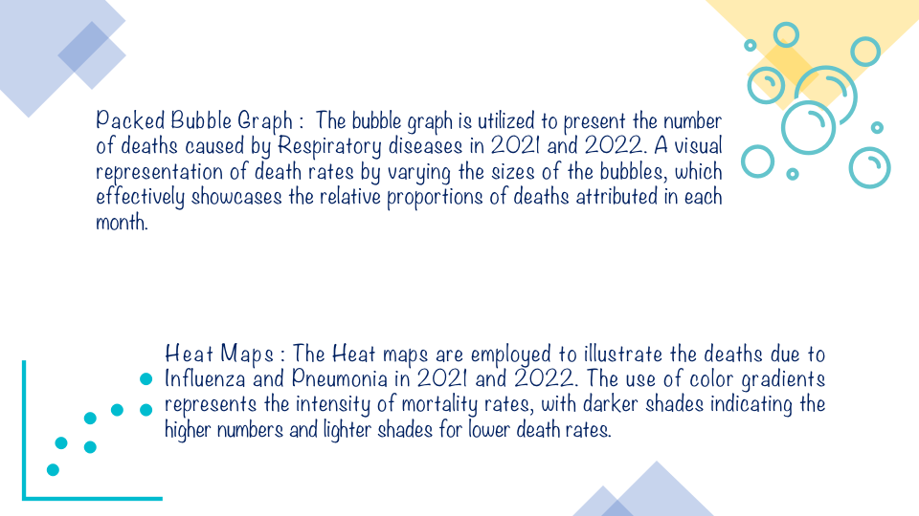

Slide 9

In summary, this poster effectively utilizes data visualization techniques to analyze care home deaths in 2021 – 2022. The color combinations, choice of visual elements and efficient use of poster space contribute to a comprehensive and easily comprehensible presentation. The histogram, line graph, packed bubble graph and heat maps enable quick understanding of key trends, changes and patterns. Furthermore, the inclusion of pictures aids to conveying complex medical information.
Overall, the poster provides valuable insights into the trends of mortality in care homes, facilitating the development of preventive measures to improve public health.

Slide 10
Thank you .

